Slide 1
The 8 golden rules of interface design
Applied to Boking.com and Trivago
Gerardo León Quintana
José Gabriel Reyes Rodríguez

Slide 2
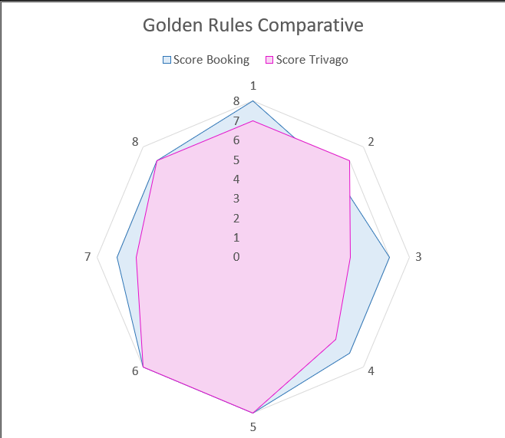
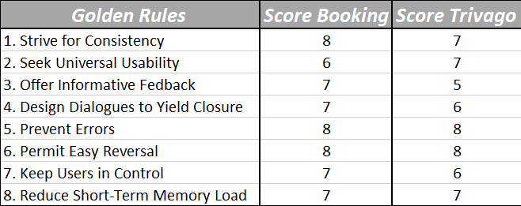
Accessibility Study - Kiviat

Slide 3
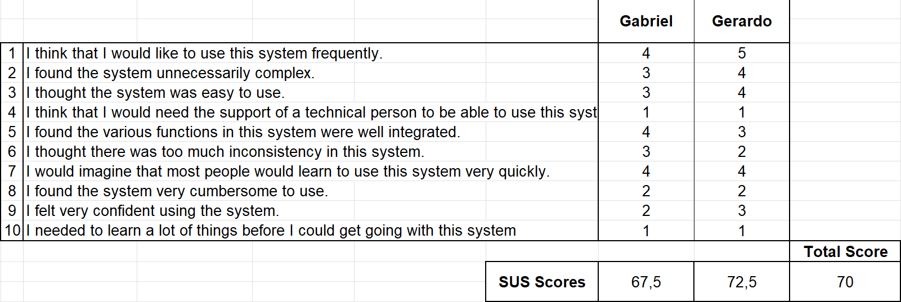
Usability Study - SUS

Slide 4
Conclusions

